Slide 1
B2B Research, Cross-tabulation Analyses, & Correlation Analyses PART I

Slide 2
REMINDERS
Term Project
You should be completing your data collection this week.
Next step is to enter, clean and code your data.
After that, you can start analyzing and the data and interpreting the findings.

Slide 3
REMINDERS
Data Analysis Quiz
Held in your PC Labs next week.
You will be provided with a questionnaire, an Excel database, and a list of instructions.
Using XLDA you will calculate sample sizes, analyze data and interpret the findings.
50 minutes to complete.
Worth 5% of your course mark.

Slide 4
Learning Outcomes
Understand the unique differences/
challenges in conducting B2B research
Not in
the text
2. Understand associations between variables
Ch 14
3. Understand where and how cross-tabulations
with Chi-square analysis are applied.
Ch 14

Slide 5
Learning Outcomes
4. Know how to construct and interpret cross-
tabulations and Chi-square analyses with
Snap and XLDA.
Ch 14
5. Understand the nature and use of correlation
analyses.
Ch 14

Slide 6
Business to Business (B2B)
Research

Slide 7
B2B Research
Research principles:
What you’ve learned so far also applies to B2B research.
Additional principles unique to B2B research.
B2B research designs vary with the nature of the business environment.

Slide 8

B2B Markets
Standardized commodity markets:
Many customers with similar needs and relationships to you/the client organization.
Research designs often resemble B2C.

Slide 9
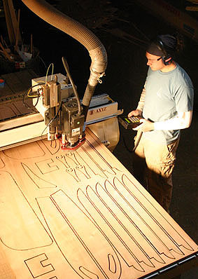
B2B Markets
Custom designed/unique product and service markets:
Relationships are based on specialty knowledge.
B2B research typically needs to be tailored to each situation.

Slide 10
B2B Research on two levels
Marketing Research Co
Client Company
B2B
Respondents:
Customer Companies
B2C
Respondents:
Final Consumers

Slide 11
Characteristics of B2B Research
B2B Research Characteristics
Small target population – sometimes a census makes more sense.
Smaller sample sizes.
Samples constitute a large % of the population.
Often faced with lack of availability of a complete and up-to-date sampling frame.

Slide 12


B2B Research Characteristics
B2B respondents are often dispersed geographically.
B2B respondents have very busy schedules.

Slide 13


B2B Research Characteristics
Incentives to participate are common place in B2B research.
Cost per completed interview are much higher in B2B research than in B2C.

Slide 14


B2B Research Characteristics
Average B2B customer often represents large sales volume.
Relationship with each B2B customer crucial.
Sales persons may be involved in customer contact and data collection.

Slide 15
B2B Research Best Practices
Design your research to help foster an improved customer relationship.
A chance to ‘reach out’ to customers and demonstrate your company’s desire for a closer relationship with its customers.
Across all phases of research.

Slide 16
B2B Research Best Practices
Gather information from across the client organization to get a complete ‘view’ of the research problem.
Typically in B2B, many people have customer contact and insights.
Allow extra time to talk to all levels of staff in the client company.
Notes:
USE MULTIPLE CONTACTS WITHIN THE CLIENT COMPANY. In firms that market to businesses, many people have customer contact and insights.
The researcher must allow extra time to talk to all levels of staff in the client organization.

Slide 17
B2B Research Best Practices
Key levels within client organizations that typically need to be consulted include:
Senior Executives
Middle Management/Supervisors
Contract Administrators/Purchasers.
Front line staff
Notes:
Interview multiple respondents within customer co.
Senior Executives:
They focus on the strategic relationship between the firms.
Contract Administrators or Purchasers:
They meet with vendors to discuss performance and contract renewals.
Daily Interactors.
They interact with their customer service or operations contacts at the vendor firm,
They have daily or frequent contact, and experience problems firsthand.

Slide 18
B2B Research Best Practices
Inform all staff with customer contact to ensure that:
Research objectives are clearly defined and understood.
Staff supports the research process.
Staff isn't blindsided by questions from their customers.
Notes:
USE MULTIPLE CONTACTS WITHIN THE CLIENT COMPANY. In firms that market to businesses, many people have customer contact and insights. The researcher must allow extra time to talk to all levels of staff in the client organization.

Slide 19
B2B Research Best Practices
Obtaining a suitable sampling frame is often challenging because customers change all the time and few companies are equipped or organized to keep on top of those changes.
Lists must be verified!
Notes:
EXPECT COMPILING SAMPLE FRAME TO BE CHALLENGING
Current and past customers: if the client does not have a formal customer relationship management (CRM) database, compiling a complete list may require a lot of time.
Potential customers: industrial associations and directories, commercial sources (e.g. Dunn and Bradstreet), list brokers. Must be verified as managers often change jobs and areas of responsibility.

Slide 20
B2B Research Best Practices
Reasons for sampling frame challenges:
Difference between current and lapsed customers – is the last point of contact being recorded?
New customers coming on stream all the time.
Customer contact information changes all the time – new telephone numbers, addresses, e-mails, etc.
Notes:
EXPECT COMPILING SAMPLE FRAME TO BE CHALLENGING
Current and past customers: if the client does not have a formal customer relationship management (CRM) database, compiling a complete list may require a lot of time.
Potential customers: industrial associations and directories, commercial sources (e.g. Dunn and Bradstreet), list brokers. Must be verified as managers often change jobs and areas of responsibility.

Slide 21
B2B Research Best Practices
In addition to current and lapsed customers, you also need to consider potential/prospective customers. Consider buying lists from:
Industrial associations and directories.
Commercial sources (e.g., Dunn & Bradstreet).
List brokers & recruiting companies.
Notes:
EXPECT COMPILING SAMPLE FRAME TO BE CHALLENGING
Current and past customers: if the client does not have a formal customer relationship management (CRM) database, compiling a complete list may require a lot of time.
Potential customers: industrial associations and directories, commercial sources (e.g. Dunn and Bradstreet), list brokers. Must be verified as managers often change jobs and areas of responsibility.

Slide 22
B2B Research Best Practices
Use creative interview methods
Use hybrid methods.
Be creative in selecting locations and times.
Use communication technologies.
Notes:
BE CREATIVE IN SELECTING INTERVIEW METHODOLOGIES
Combine modalities (ex initial phone contact with emailed questionnaire)
Be creative in selecting contact places and times (ex: during conferences, user group meetings, annual review meetings)
Use communication technologies (ex: online focus groups, teleconferencing etc.)

Slide 23
B2B Research Best Practices
Use specially trained interviewers
Must understand the industry.
Must be able to converse at a professional business level.
Sometimes client firms want to use their own staff – avoid if at all possible!
B2B interviewers typically cost more money and are usually worth it.
Notes:
A:
Possible if the staff receives training.
Not uncommon when key accounts are interviewed – in companies subscribing to relation-ship selling philosophy.

Slide 24
B2B Research Best Practices
Design the questionnaire for a busy respondent
Short and simple.
Engaging and interesting.
Don't automatically make replies anonymous.
Notes:
DESIGN THE QUESTIONNAIRE FOR A BUSY RESPONDENTS
Short and simple. Short surveys may leave some questions unanswered, but can become the basis for a continuing dialogue with valued customers.
Engaging and interesting. A questionnaire that asks engaging and interesting questions and allows the respondents to express their own opinions in a conversational way (instead of just giving dry lists of ratings) can be a relationship building experience.
Don't automatically make replies anonymous. B2B customers often feel a bond with the supplier and may prefer to have their answers reported by name. Ask the respondent at the beginning of the interview about this.

Slide 25
Cross-tabulation Analyses

Slide 26
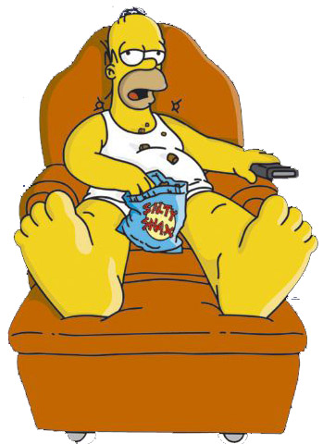
What kind of television viewer are you?

Slide 27
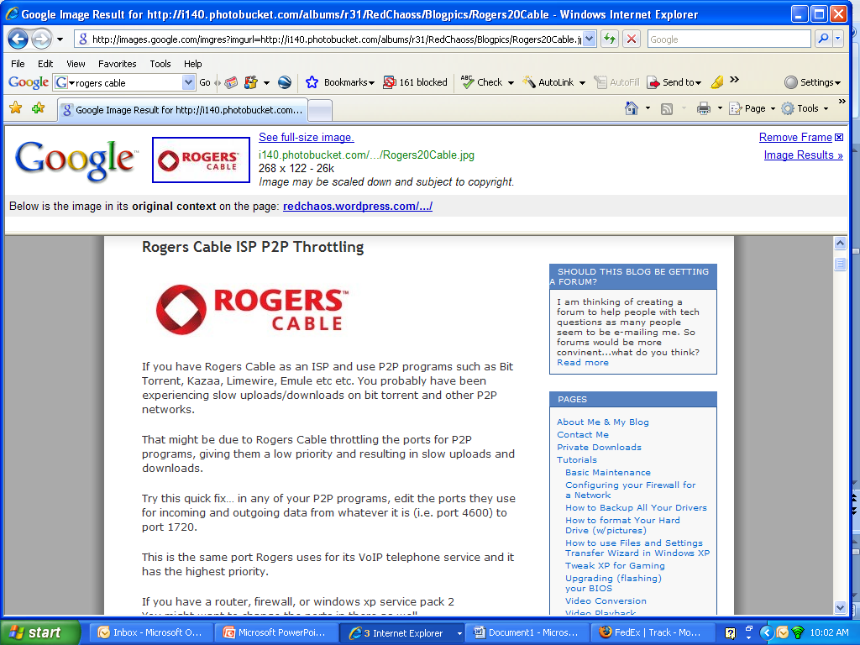
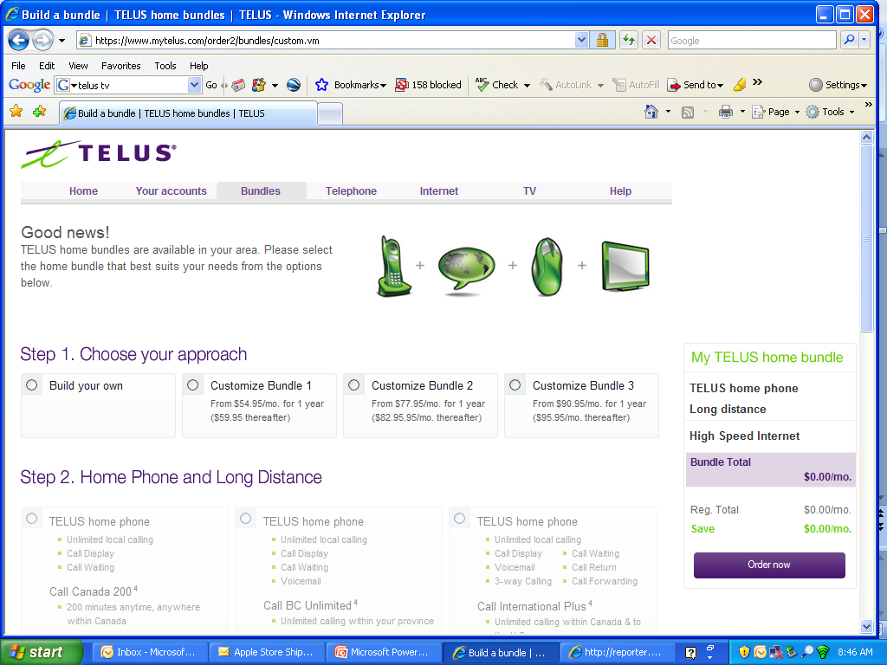
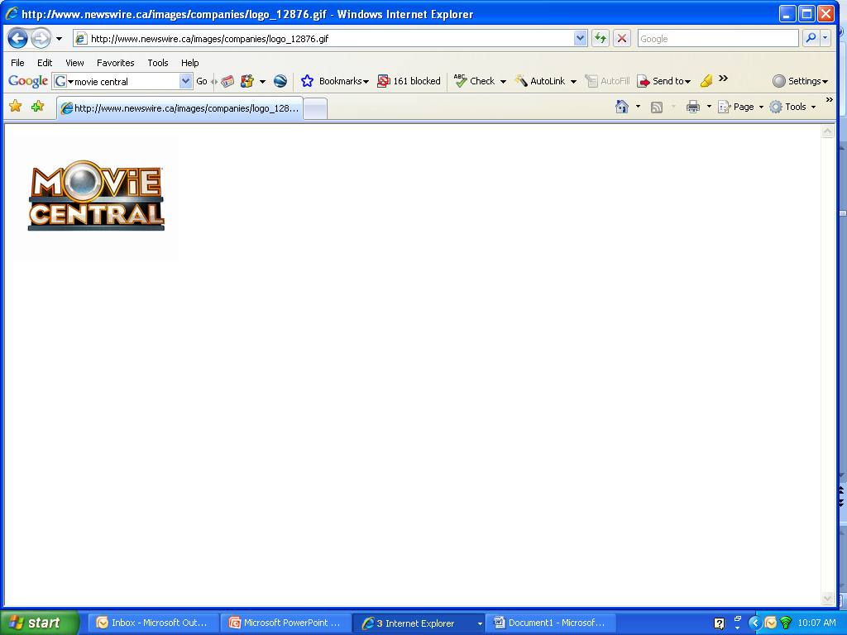
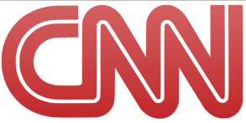
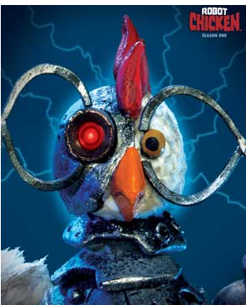
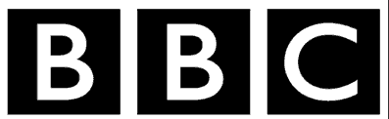
Who is your cable provider?
What genres do you like to watch – comedy, news, sports, drama, history?
What channels do you typically turn to?
What are your favourite shows?
Do you have HD?

Slide 28
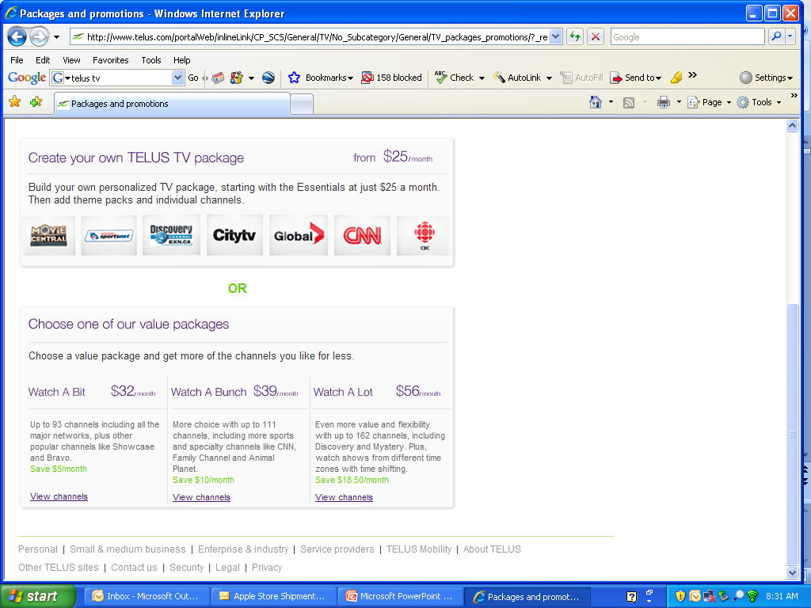

Slide 29
Telus TV
Marketing Questions:
Who are our current customers?
Who are our prospective customers?
What is the current television watching behaviour of each group?
How do we identify the program ‘bundles’ that will appeal most to different types of television viewers?

Slide 30
Telus TV
The answers to these questions:
Marketing research
Statistical analysis of research data
Some statistical methods are particularly powerful in identifying segments…
you learn about them today…

Slide 31
Associative Analyses
Associative Analyses: determine where stable relationships (i.e., ‘associations’) exist between two variables.
Examples:
What promotional appeals yield the highest levels of purchase intent?
What demographic variables are associated with purchase of specific Telus services?
Is purchase intention of a TV bundle associated with actual sales?

Slide 32
Relationships Between Two Variables
Relationship: a consistent, systematic linkage between the levels or labels for two variables.
Labels: refers to the description for nominal or ordinal scales.
E.g., buyers v. non-buyers.
Levels: refers to the characteristics of interval or ratio scales.
E.g., number of household members.
Notes:
As we shall see, this concept is important to understand …

Slide 33
Relationships Between Two Variables
Four types of relationships:
General Relationship
Directional Relationship
Linear Relationship
Curve-linear Relationship
Notes:
We’ll look at each of these and understand why these are important

Slide 34
Relationships Between Two Variables
1. General Relationship:
Two variables are associated, but only in a very general sense.
We do know that the presence (or absence) of one variable is associated with the presence (or absence) of another.
We don’t know “direction” of relationship.

Slide 35

Application: General Relationship
E.g., McDonald’s found that:
Customers buying breakfast typically also order coffee.
Lunch customers tend to order soft drinks.

Slide 36
Application: General Relationship
In research lingo:
There is a General Relationship between the type of the meal and type of drink ordered.
With the presence of one variable value (e.g. type of meal = breakfast) you tend to find the presence of the other variable value (type of drink = coffee).
This is not an exclusive relationship – no guarantee that all breakfast customers order coffee.

Slide 37
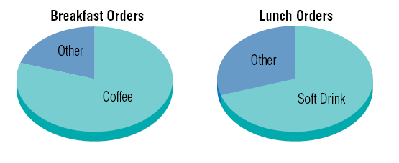
Application: General Relationship

Slide 38
Relationships Between Two Variables
2. Directional Relationship:
The direction of a relationship between two variables is known.
Direction can be:
Increasing
Decreasing
Example:
Telus found that bundling specific television channels together resulted in greater purchase intention.

Slide 39
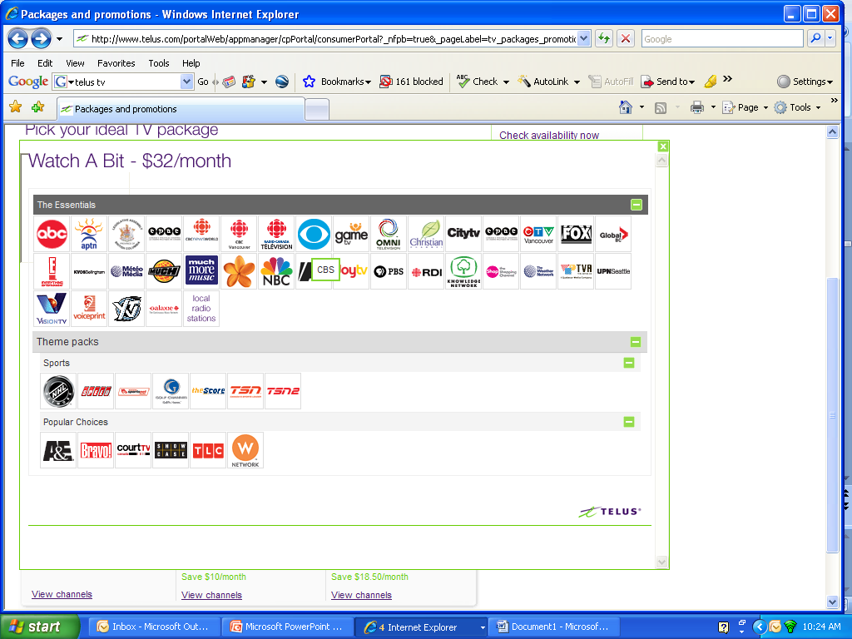
Basic bundle aimed at people who do not watch a lot of television and likely do not have children in their household.
Notes:
This is the basic Telus TV ‘bundle’. This bundle is aimed at the person that doesn’t watch an inordinate amount of television and likely doesn’t have children living in their household.

Slide 40
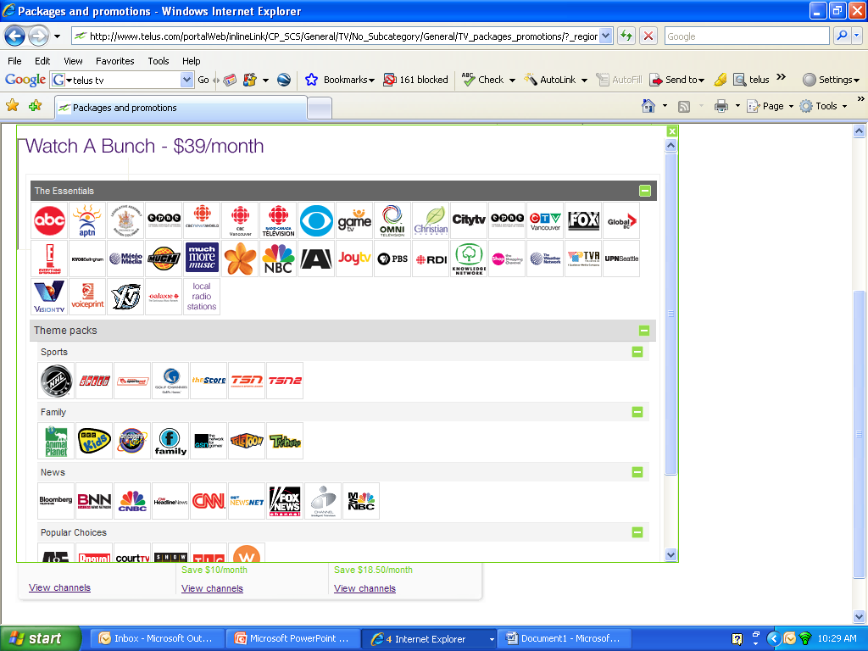
This bundle is aimed primarily at families with young children.
Notes:
This is Telus TV’s middle of the road bundle. Note that there are more news and family channels included than in the basic bundle. This bundle is primarily aimed at families with young children.

Slide 41
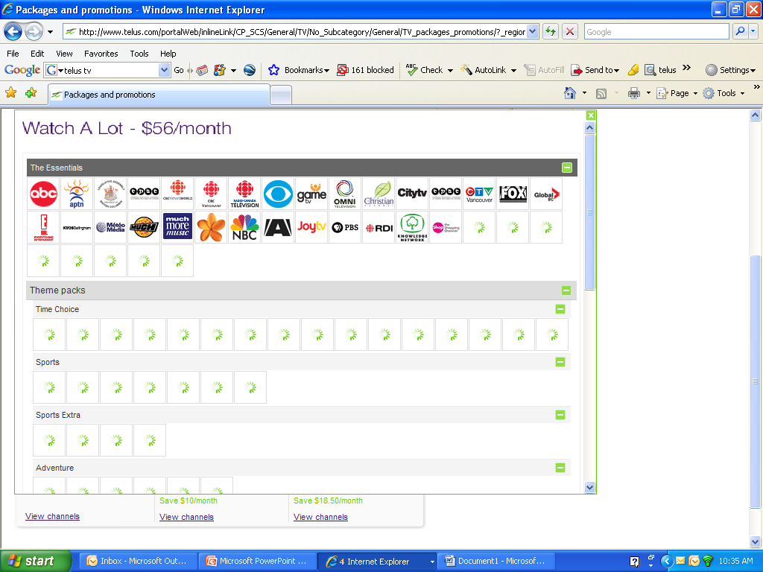
Top-of-the-line bundle aimed at households with a number of different types of viewers and those who watch a lot of television.
Notes:
This is Telus TV’s most elaborate package, providing customers with 162 channels (many of them customizable – that’s what the green swirls on the slide mean and it’s why you would have to scroll down to see all of the different theme packs that are included) and including time shifting. This bundle will appeal primarily to households with a number of different types of viewers (seniors, adults, teens, young children) and to the true TV addict.

Slide 42
Telus TV
Some of the other features that Telus tested to develop the most attractive ‘bundles’ included:
the price of the ‘set-top box’ required to operate Telus TV (including included trade-off analyses),
price of installation, and
free trial offers.

Slide 43
Telus TV
Focus group research was conducted across Alberta and British Columbia to develop and refine initial bundle concepts.
Extensive survey research was then conducted to further test and refine bundle features and, ultimately, determine the ones that would be the most marketable.

Slide 44
Relationships Between Two Variables
3. Linear Relationship:
“Straight-Line” association between 2 variables.
Knowledge of one variable will yield knowledge of another variable.
y = b + mx
y = dependent variable b = intercept
x = independent variable m = slope
E.g., The average breakfast meal at McDonalds is $4.35. For every 1,000 customers (x) the revenue (y) is $4,350.
Q: What is the dollar value of b in this example?

Slide 45
Linear Relationship
Q: In terms of Telus TV, what does the value of b mean?
Sales of Bundles
Number of bundle features
The number of features included in a Telus TV bundle (X) has a direct and positive effect on bundle sales (Y).
© 1984-1994 T/Maker Co.
Notes:
28
A: There is a base amount of sales (b) that would occur without any advertising.

Slide 46
Relationships Between Two Variables
4. Curve-linear:
Smooth curve pattern describes the relationship.
E.g., Technology adoption is S-shaped.

Slide 47
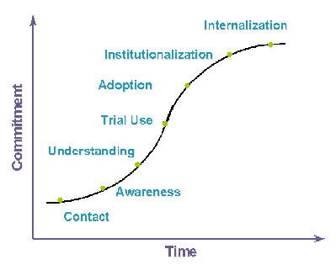
Curve-linear Relationship
Technology
Adoption
S-Curve
Notes:
Starts slowly, then gains momentum and finally levels off again

